Slide 1
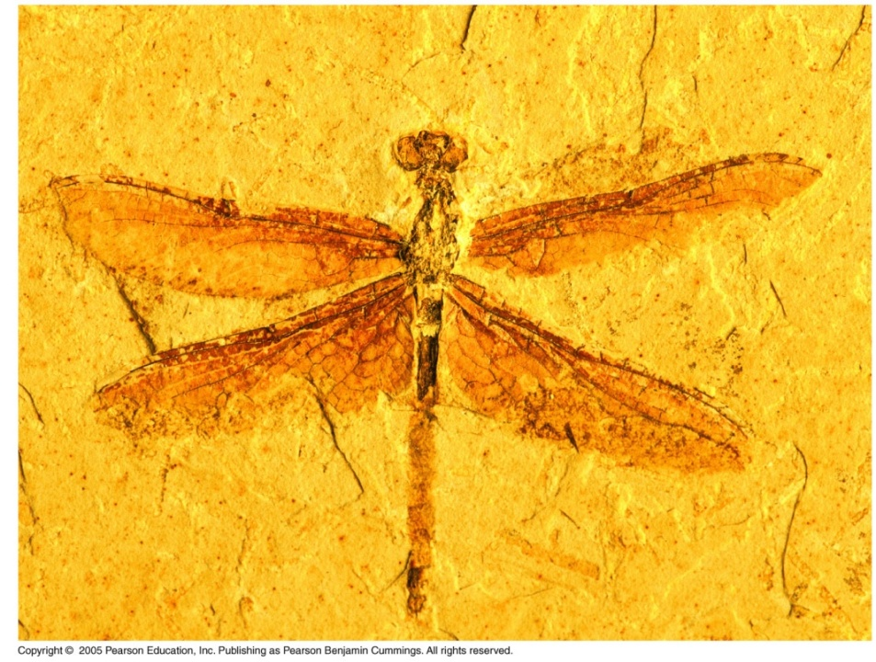
Chapter 26
Phylogeny and the Tree of Life

Slide 2
What you need to know:
The taxonomic categories and how they indicate relatedness.
How systematics is used to develop phylogenetic trees.
The three domains of life including their similarities and their differences.

Slide 3
Systematics: classifying organisms and determining their evolutionary relationships
Taxonomy
(classification)
Systematics
Phylogenetics
(evolutionary history)

Slide 4
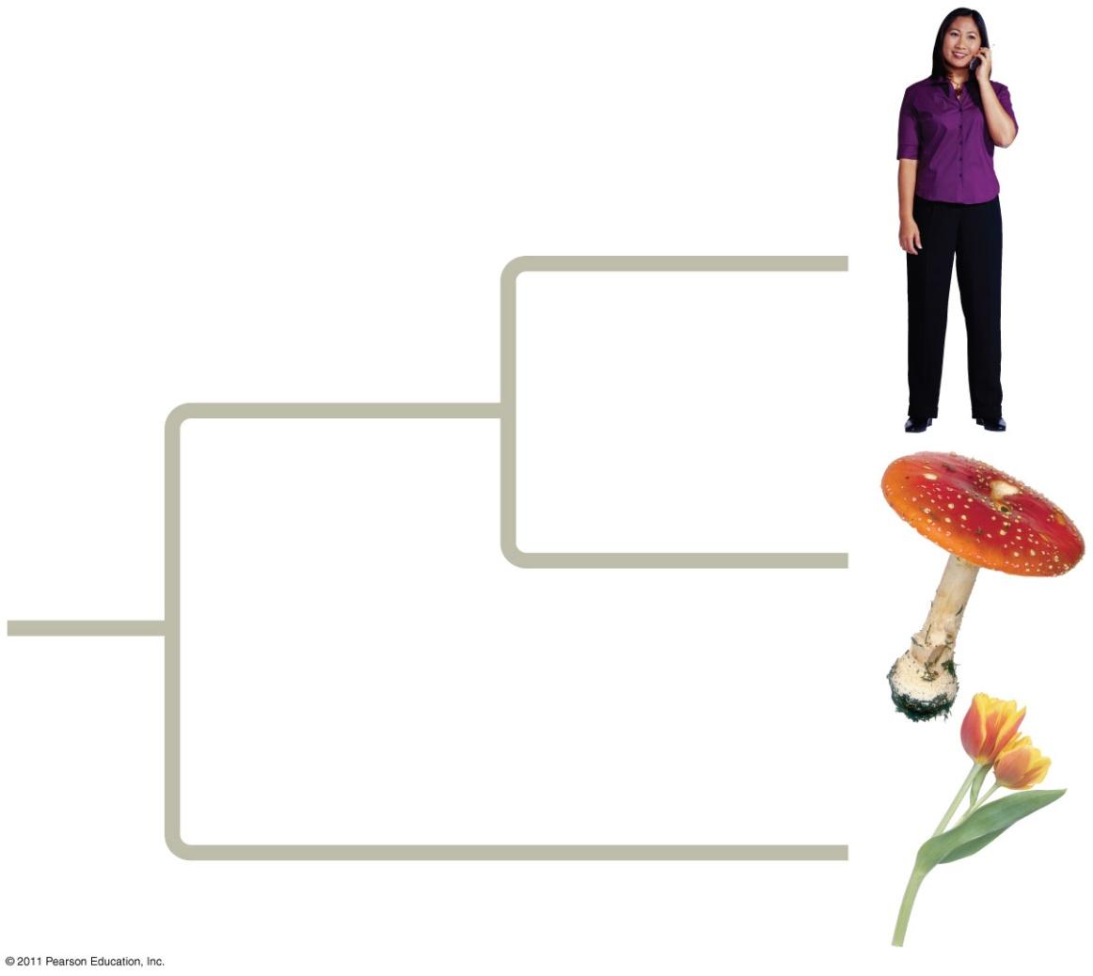
Tools used to determine evolutionary relationships:
Fossils
Morphology (homologous structures)
Molecular evidence (DNA, amino acids)
Who is more closely related?
Animals and fungi are more closely related than either is to plants.

Slide 5
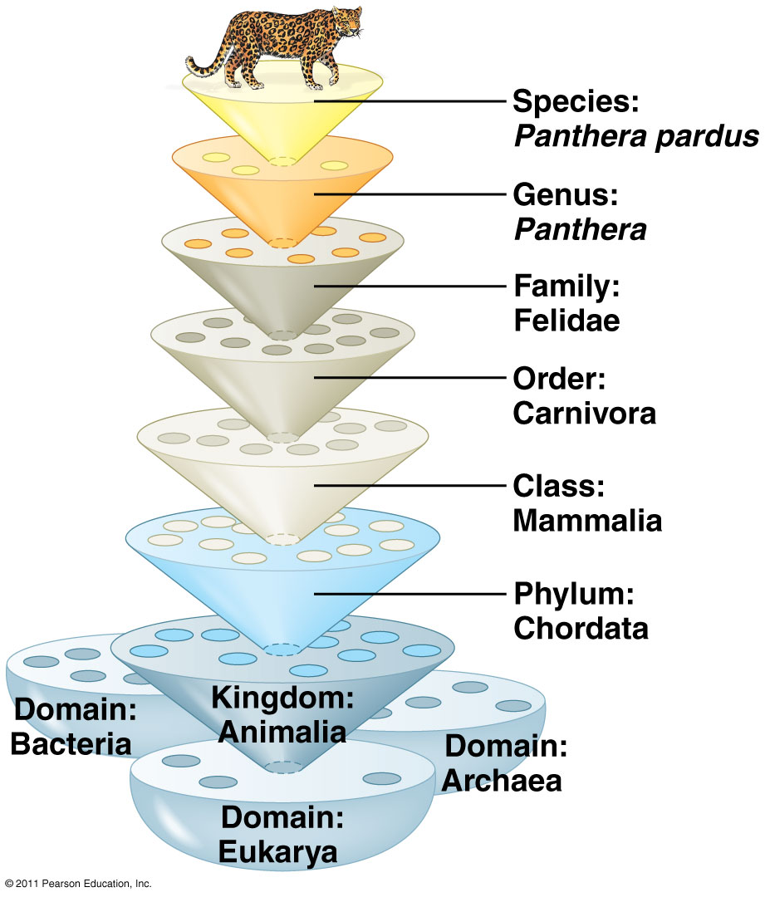
Taxonomy: science of classifying and naming organisms
Binomial nomenclature (Genus species)
Naming system developed by Carolus Linnaeus.

Slide 6
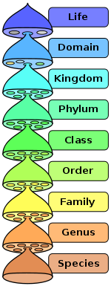
REMEMBER!!
Dear King Philip Came Over For Good Spaghetti
Dear King Philip Crossed Over Five Great Seas
Dear King Philip Came Over From Germany Stoned
Your own???

Slide 7
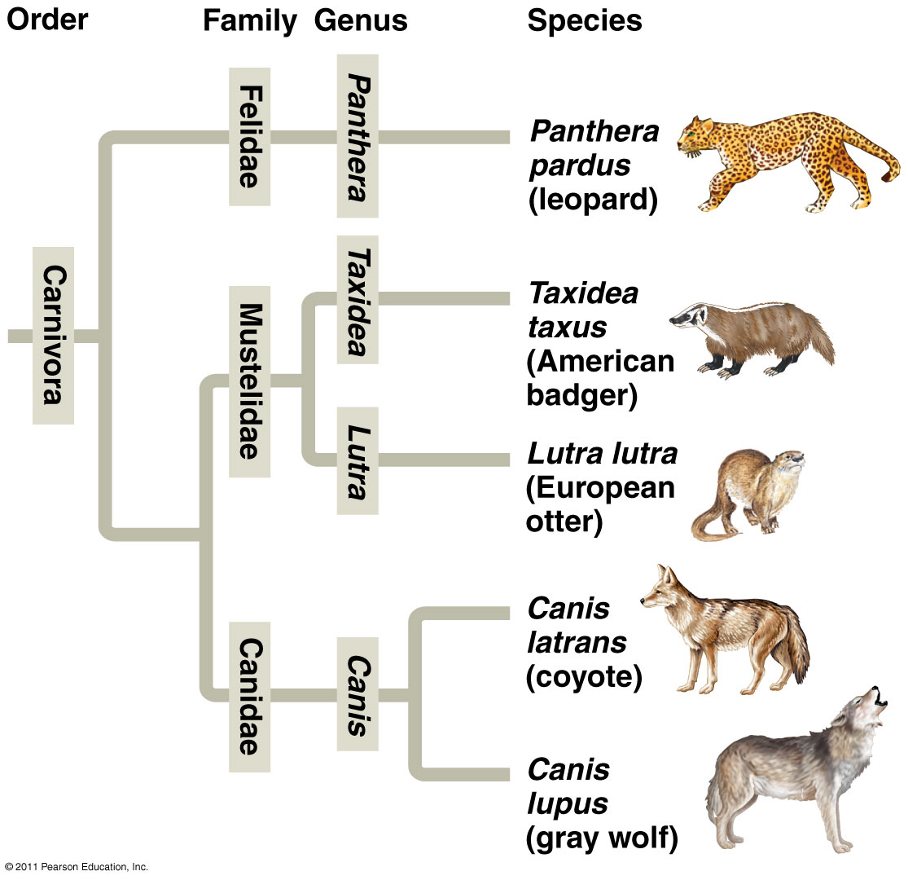
Phylogenetic Tree
Branching diagram that shows evolutionary history of a group of organisms

Slide 8
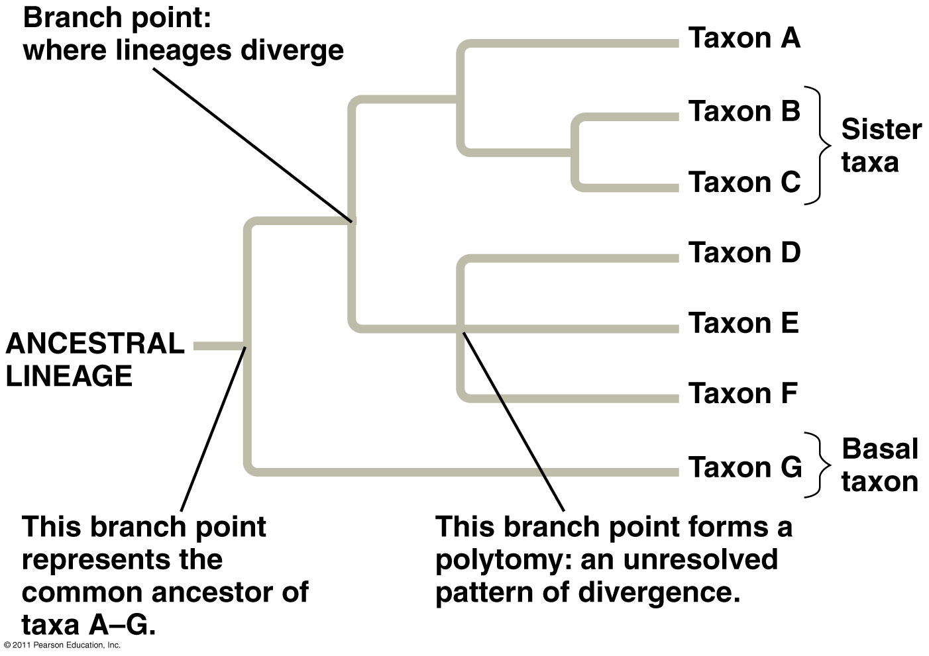

Slide 9
Activity: Constructing a Cookie Phylogenetic Tree

Slide 10
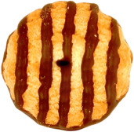
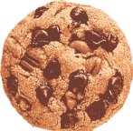
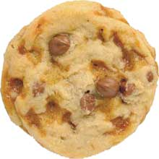
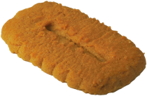
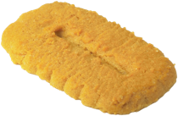
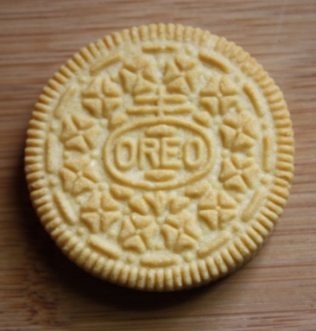
Living (extant) species
Common ancestor
(fossil)

Slide 11
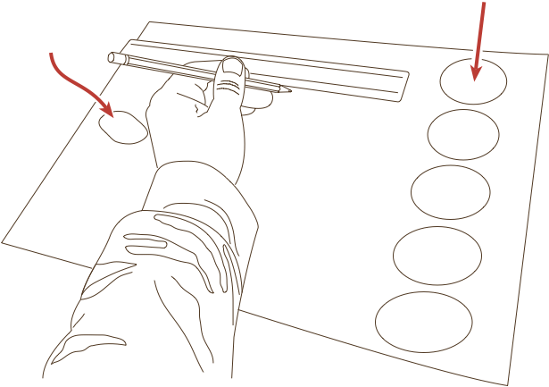
Extant species
Common
ancestor

Slide 12
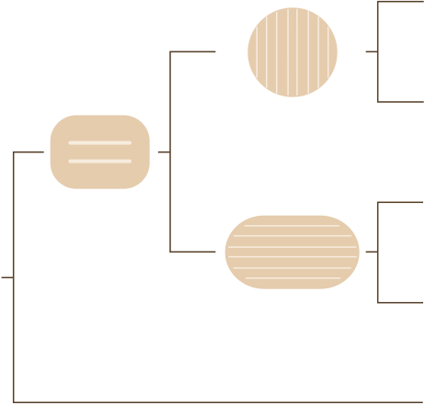
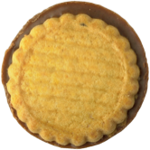
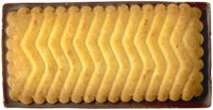
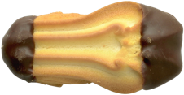
Example of a Cookie Tree

Slide 13
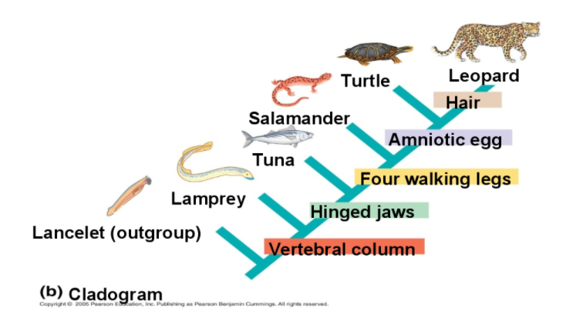
Clade = group of species that includes an ancestral species + all descendants
Shared derived characteristics are used to construct cladograms

Slide 14
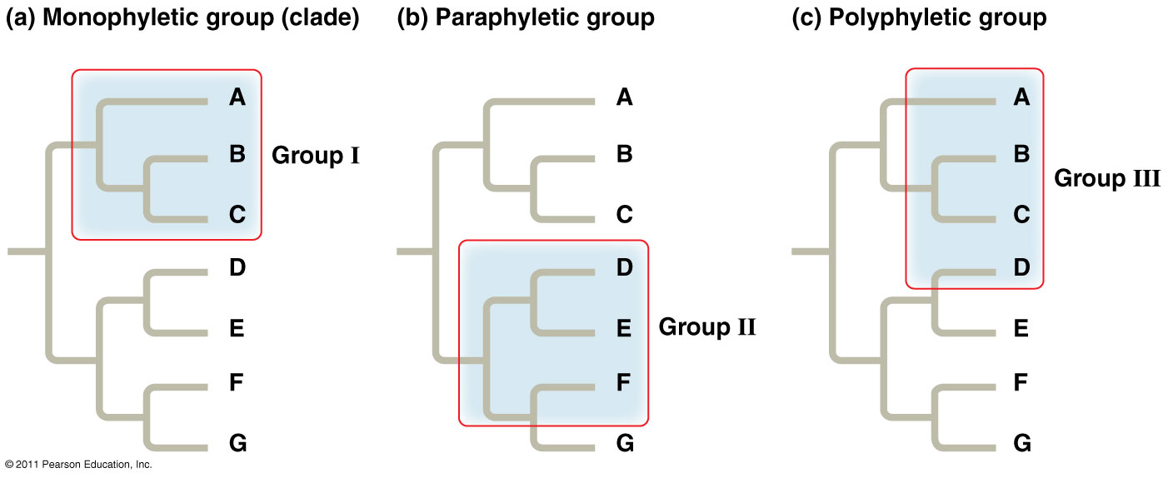
Monophyletic, paraphyletic, and polyphyletic groups

Slide 15
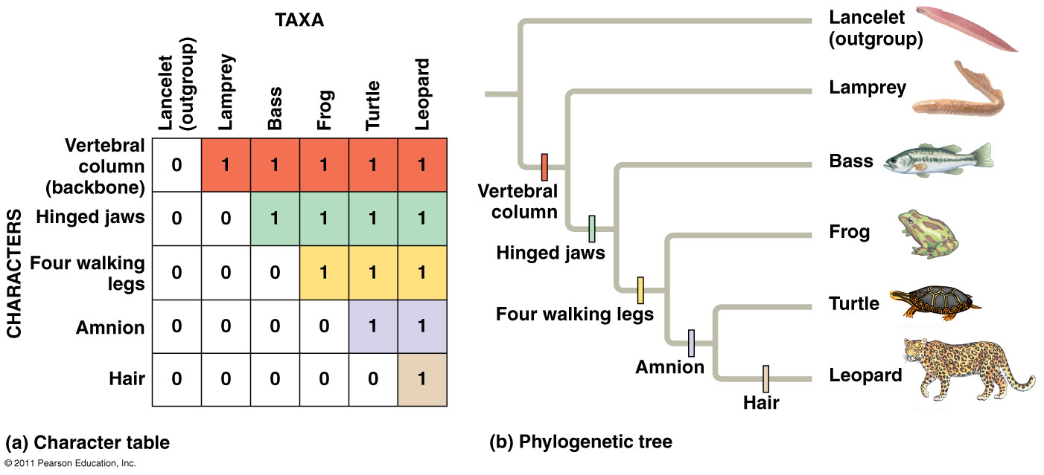
Constructing a phylogenetic tree
A 0 indicates a character is absent; a 1 indicates that a character is present.

Slide 16
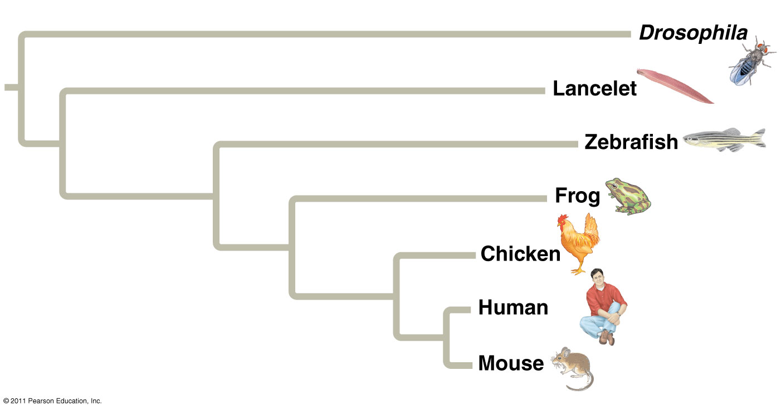
Branch lengths can represent genetic change

Slide 17
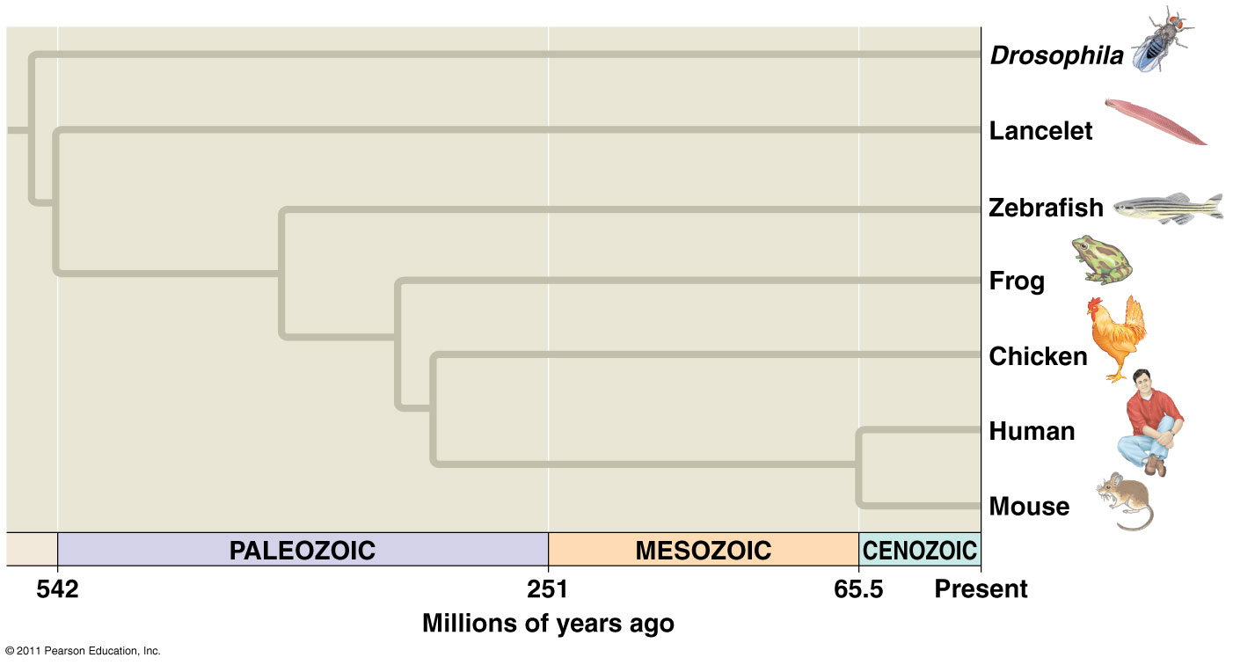
Branch lengths can indicate time

Slide 18
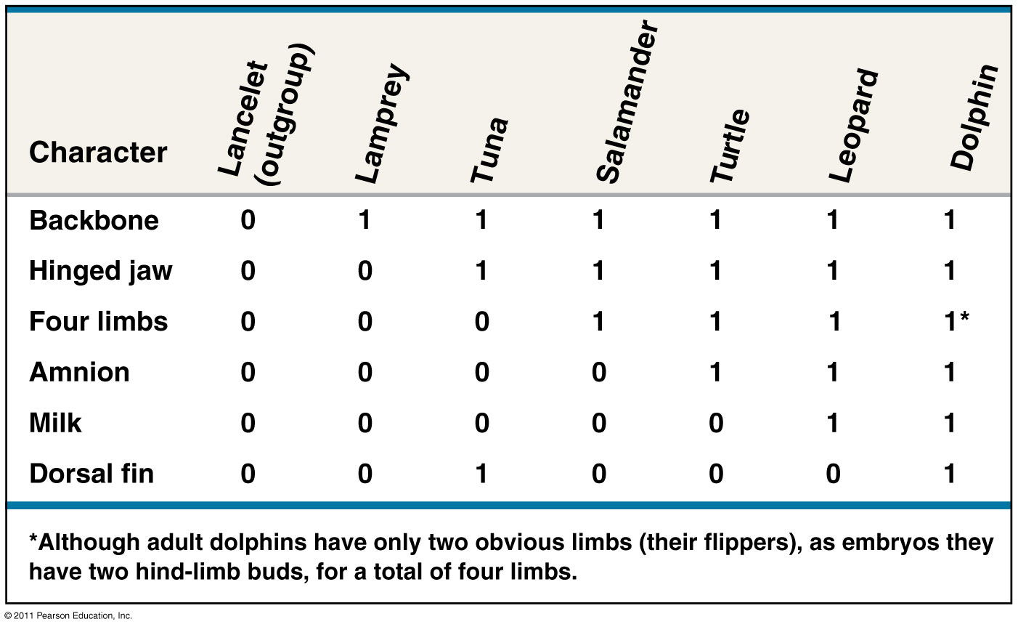
Draw a phylogenetic tree based on the data below. Draw hatch marks on the tree to indicate the origin(s) of each of the 6 characters.

Slide 19
Answer:

Slide 20
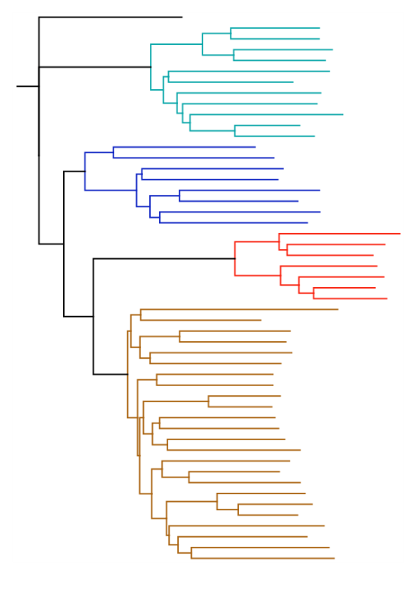
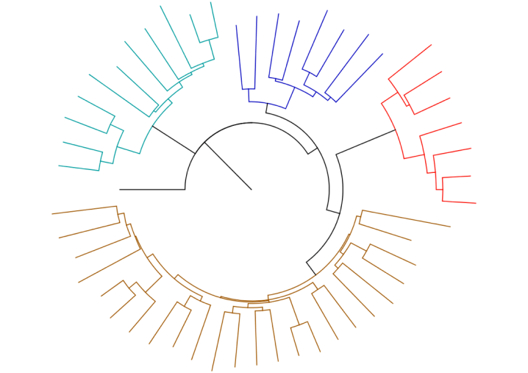
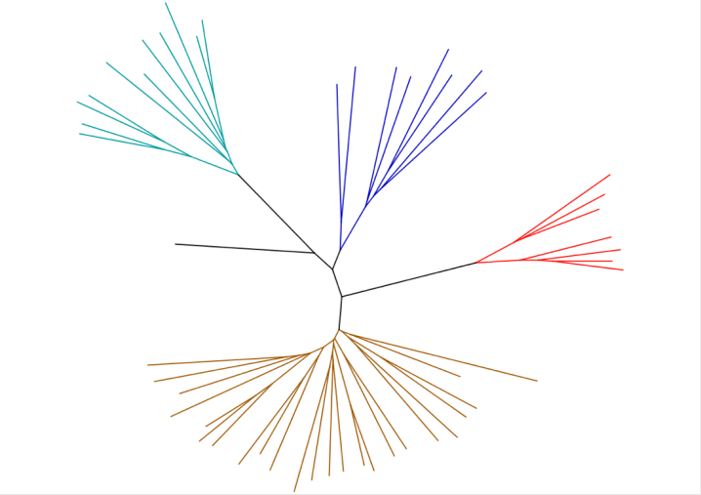
Various tree layouts
Circular (rooted) tree
Unrooted tree
Rooted tree

Slide 21
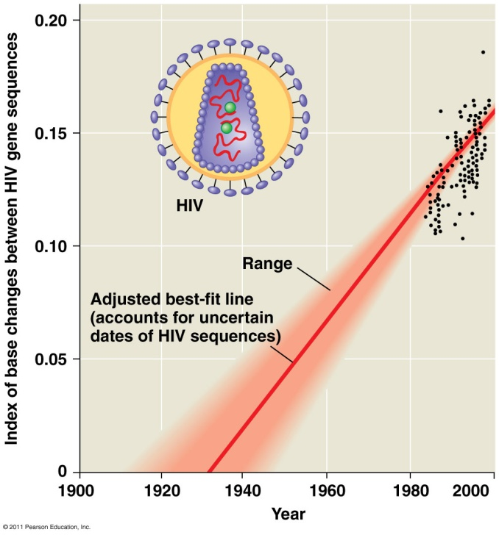
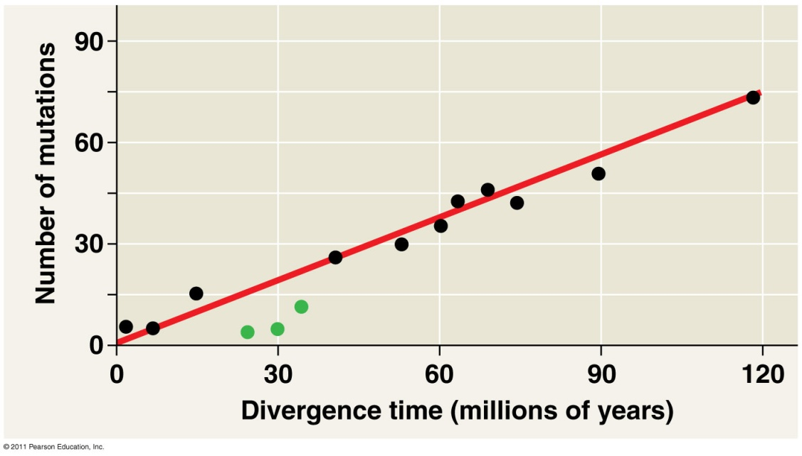
Principle of maximum parsimony: use simplest explanation (fewest DNA changes) for tree – “keep it simple”
Molecular clocks: some regions of DNA appear to evolve at constant rates
Estimate date of past evolutionary events
Eg. Origin of HIV infection in humans= 1930’s

Slide 22
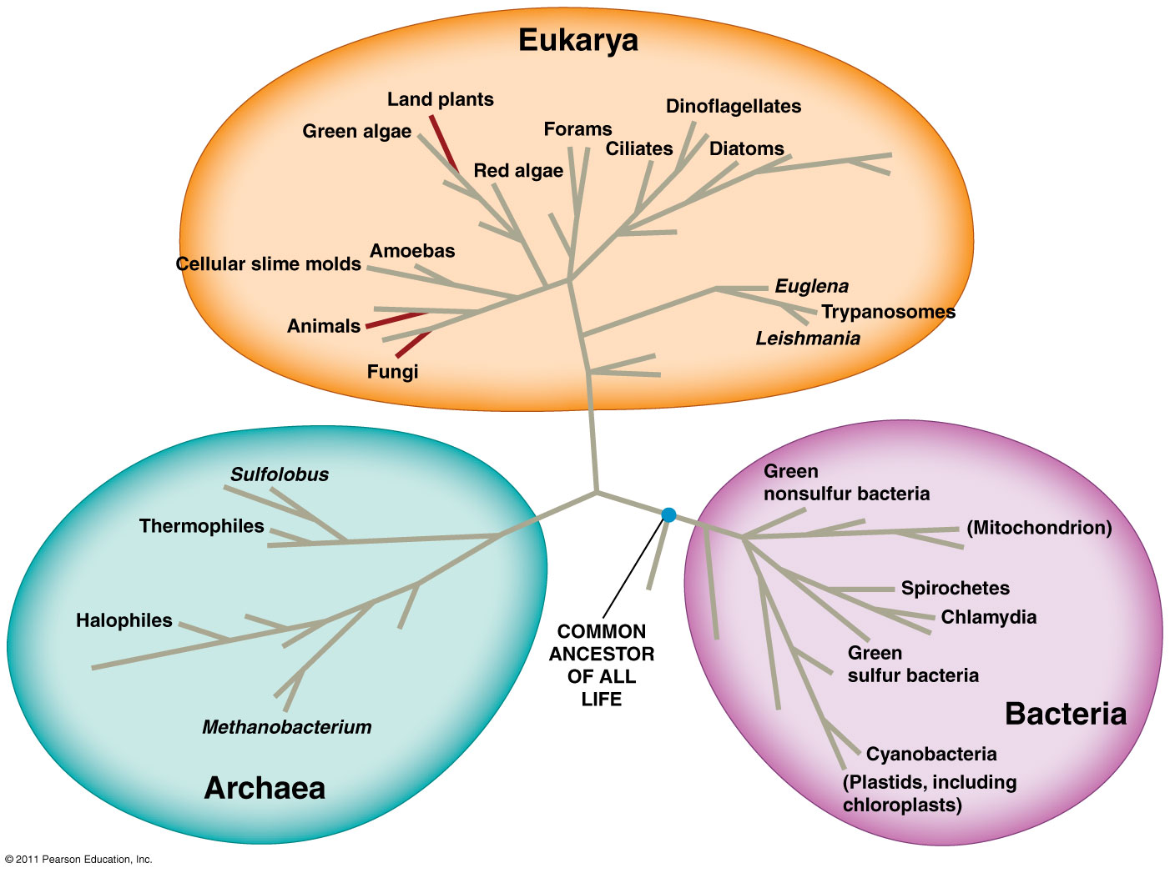
Tree of Life
3 Domains: Bacteria, Archaea, Eukarya

Slide 23
SYSTEMATICS
focuses on
phylogeny
Biological diversity
taxonomy
cladistics
classification
Identification of species
D
K
P
C
O
F
G
S
Homologous
similarities
fossils
binomial
molecular
Genus, species
morphology

